Slide 1
EuchreAI - Euchre Player AI
Final Presentation – Team 8
Andrew Klenotic & Dylan Stavarz

Slide 2
Recap: The Situation
Euchre is a card game played by four individuals in 2 teams of 2.
Coordinating schedules to allow four people to play at the same time can be difficult.
Last minute conflicts can cause one or more players to be unable to participate on short notice.
In these cases having a remedy to replace one or more players by a computer AI would be useful.
The computer AI would be designed to replace the human player at a real table in order to preserve the feel and enjoyment of actual tabletop play and social interaction absent in a fully computerized game.

Slide 3
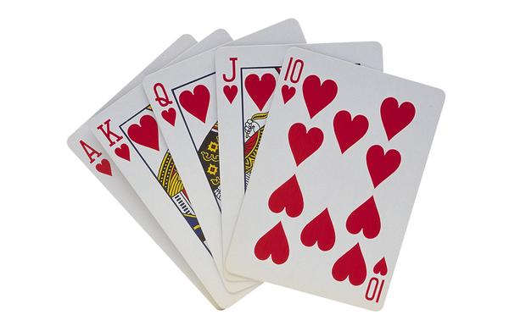
Recap: The Parameters: (For Common Rules)
3
Uses the cards 9 through Ace of each of the four suits, for 24 cards.
Each player is dealt 5 cards.
Partners generally can not actively communicate with each other.
The options at any point in the game are finite and can be enumerated.
The winning conditions (or goal state) can be defined.

Slide 4
Internal Representation
Rank | 9 | 10 | Jack | Queen | King | Ace
Integer | 9 | 10 | 11 | 12 | 13 | 14
Suit | Spades | Diamonds | Hearts | Clubs
Character | S | D | H | C
struct Card {
char suit;
int size;
}
The AI’s hand is represented as a 5 value array of type Card.
The cards played are represented in a separate array.

Slide 5
Program Implementation
Written in C++ 11 under the Linux Operating System
Nearly 1200 lines of code with over 35 functions.
Written completely from the ground up.
Produces Log files for analysis of the AI operations.
Uses eSpeak system calls for voice synthesis.
Implements two personas, one male (John) and one female (Jane) for interaction.

Slide 6
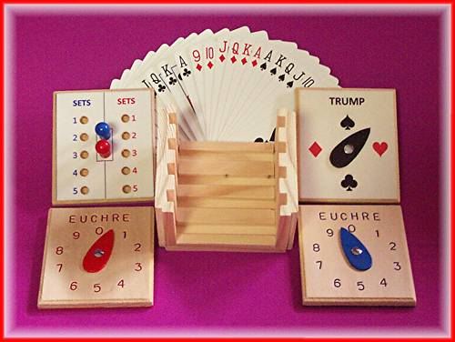
The Requirements: MET!
6
Computer AI is able to make decisions in the Calling Round regarding the selection of the suit for Trump.
On the computer’s turn, the AI is able to analyze the cards played in the current trick and make an optimal play based on the cards in the AI’s “hand”.
The AI knows when it is its turn to play and will indicate to the human players which card will be played.

Slide 7
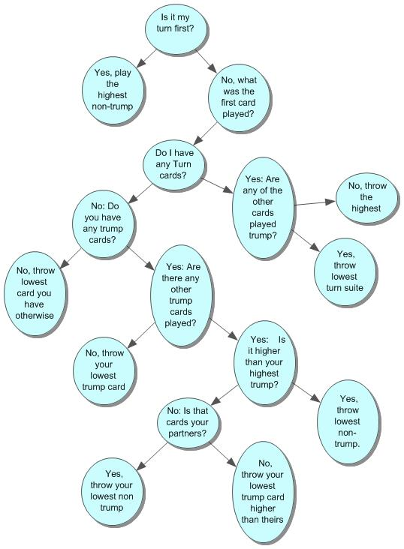
Decision Tree (For a given Trick)

Slide 8

The Stretch Goals Update:
8
Creating a method to allow the computer to actually take the role as dealer (physically dealing the cards) was not deemed feasible at this time.
Communicating the AI actions through voice was successfully implemented.
Optimized strategy during the Calling Round was achieved although we chose to not implement “Go It Alone” at this time.
Ability for the AI to keep score was implemented successfully.

Slide 9
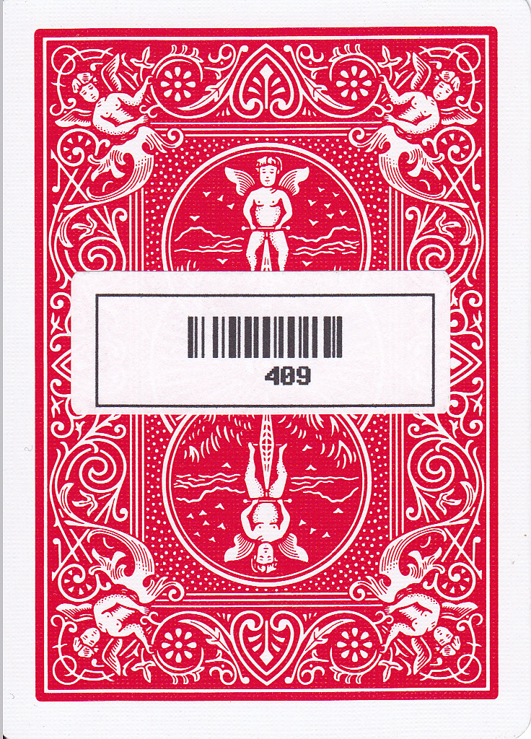

Interface Implementation
Barcode Implementation
The implementation of the barcode reader and the barcode printed cards was successful and made testing easier while preserving the game flow.

Slide 10
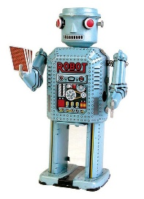
The Future of EuchreAI:
Implementation of the ID3 algorithm using C4.5 to enhance the decision tree.
Updates will be conducted through a website that will allow downloading of the client and collection of the data.
Implementation of a GUI and portability to different platforms to facilitate a wider test range.
Correction and tweaking of the current AI processes.

Slide 11
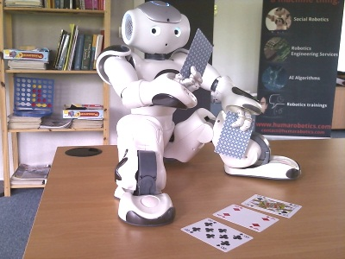
The Future of EuchreAI (Continued):
Addition of voice analysis to bypass the need for any keyboard input.
Addition of robotic elements to handle the physical acts of dealing, card recognition and card playing without any (or minimal) human assistance.
The ultimate evolution of the project would be a completely self contained EuchreBot.

Slide 12
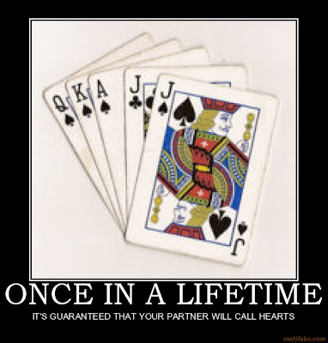
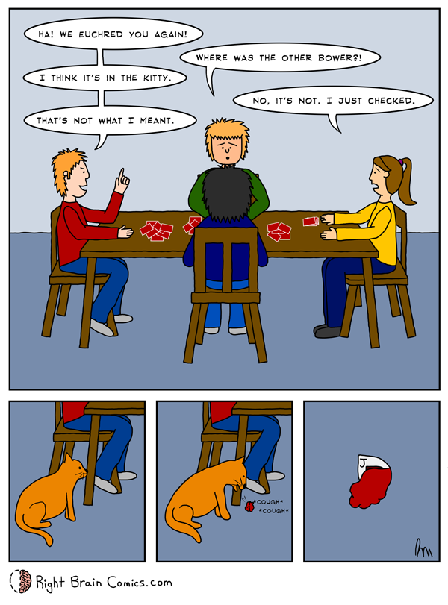
Questions? Comments? Conclusion!
12

